Slide 1
MMX Droid Fest
27 – 28 June 2015
Team BROids
Bhavana Chakhri Dawar Brijesh

Slide 2


Slide 3
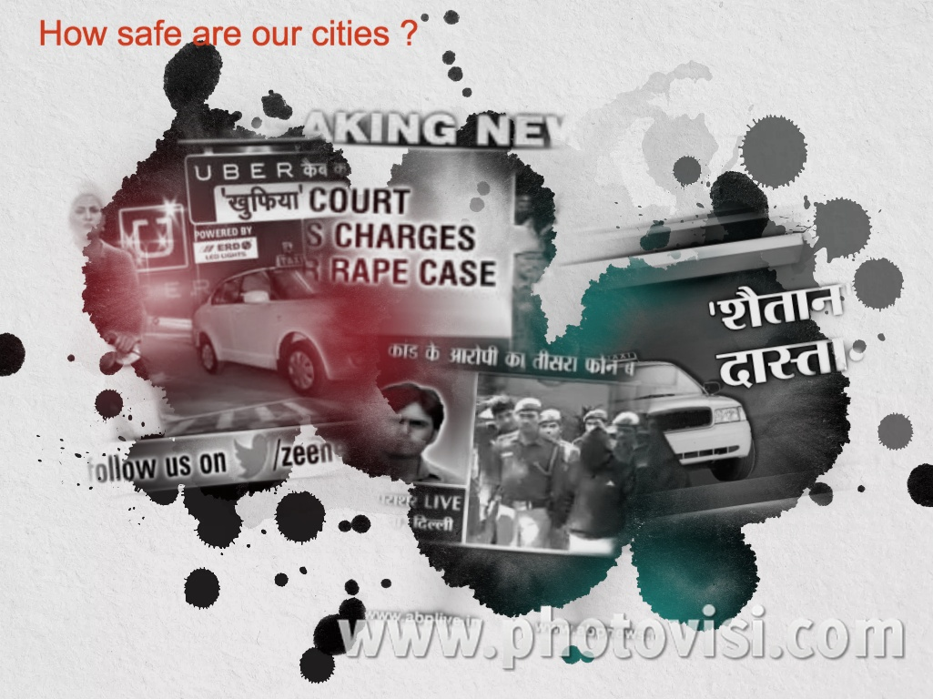
A bad Question…

Slide 4
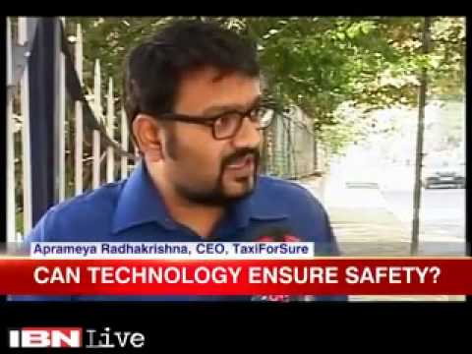
A very Good question…

Slide 5

Safe
Safe and Secure Travel

Slide 6
How YuSafe works… 3 simple steps
Enter Destination
Share Journey
Travel Safely
Current location as the starting point
Save your favorites locations like Home, Office, School etc
Save any regular trips
Select up to three contacts to track you
Set up defaults like family, team etc
Trip History
Real Time Tracking
Emergency SOS
Phone switch off alert
Out of coverage alert
Click Driver or License Plate pic
Violence detection *
Route Deviation alert

Slide 7
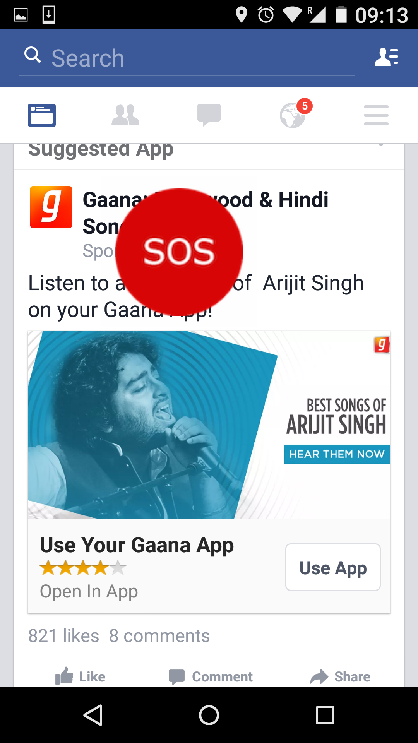
YuSafe Features: Emergency SOS
SOS button always available
Floating button over other apps
Calls primary contact tracking your journey automatically

Slide 8
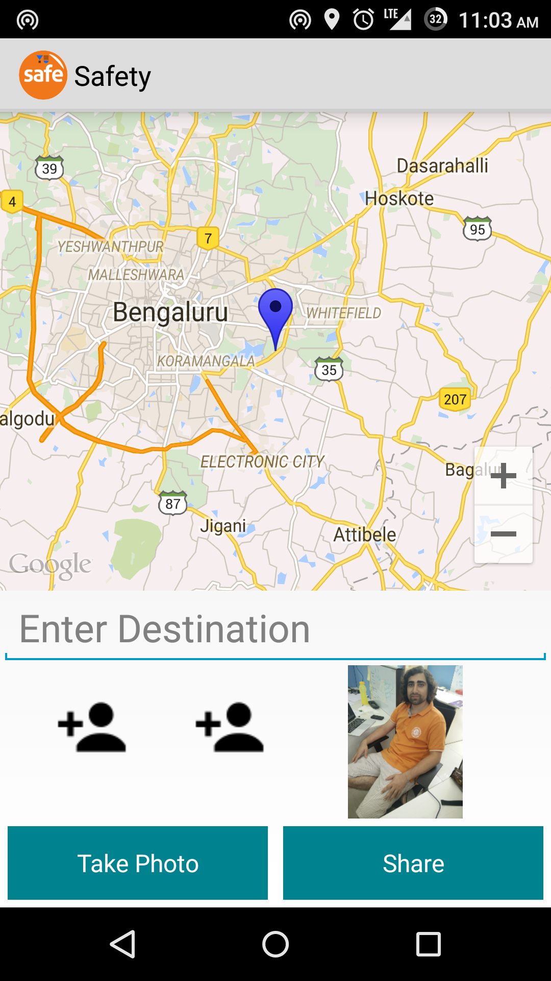
YuSafe Features: Capture Driver Details
Click driver photo or cab license plate number
Keeps record of your travel
Can be shared with your tracking contacts *
Helps Police in case of any unfortunate event

Slide 9




YuSafe: Safety | Concern
Real Time Tracking
Smart Alerts to take proactive action without user interference
Let the driver know his details have been captured and sent to others
Always know where your loved ones are during travel
Get notified of possible dangerous events
Get last know location
Make calls directly

